Slide 1
Topic: Trigonometry
EQ: What is special about the ratio of opposite and hypotenuse sides in a right-angle triangle?

Slide 2
The Daily 5
On a right-angle triangle, what side is opposite the right angle?
State the gradient and y-intercept of the following equation of a line: y = -2x + 10?
Define inverse proportion.
What is one feature of similar triangles?
5. Jagheet drives from his house to his cottage, 75 km away, maintaining an average speed of 60 km/h. How long, in minutes, does it take him to drive to his cottage?

Slide 3
Topic: Trigonometry
EQ: What is special about the ratio of opposite and hypotenuse sides in a right-angle triangle?
For this investigation, you will be working with a partner. You will need:
A large pre-drawn right angle triangle (from your teacher). Teachers use the 30-60-90 worksheet.
To draw the following table in your books:
Triangle | Length of side opposite 30∘ angle | Length of hypotenuse
1
2
3
4
5
6
7
8
9
Notes:
For this part,

Slide 4
Topic: Trigonometry
EQ: What is the relationship between the hypotenuse and opposite sides in a right-angle triangle with a 30∘ angle?
After you have recorded the values for the opposite side length, hypotenuse and the ratio for your triangle, go and find another group’s triangle. Your task is to observe:
How is your triangle the same or different to the other group’s triangle?
What mathematical word describes the relationship between the two triangles?
Record your partner group’s opposite side and hypotenuse lengths as well as the ratio
Repeat until you have the side lengths and ratios for all 9 triangles
Notes:
Teachers, two of the triangles don’t have side lengths. Give these to your stronger students to measure and use Pythagoras’ theorem to solve

Slide 5
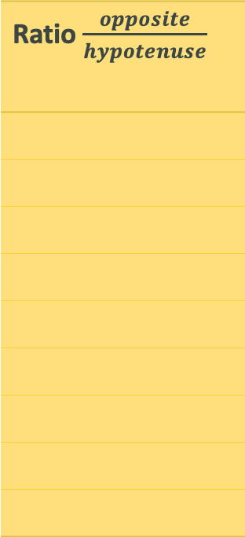
Topic: Trigonometry
EQ: What is the relationship between the hypotenuse and opposite sides in a right-angle triangle with a 30∘ angle?
There is an interesting relationship between the two sides of our triangles.
Has anyone noticed it?
Triangle | Length of side opposite 30∘ angle | Length of hypotenuse
1
2
3
4
5
6
7
8
9
Ratio $\frac{opposite}{hypotenuse}$
If you’re still unsure, add the
following column to your chart and calculate the ratios

Slide 6
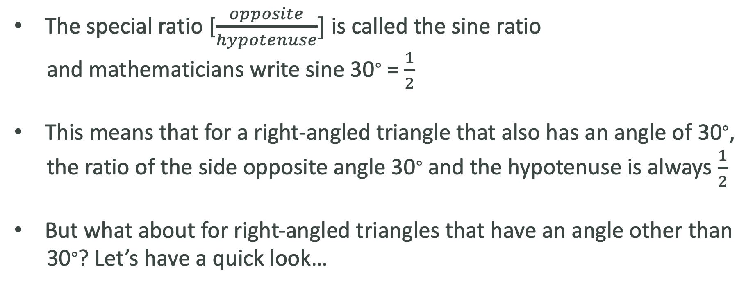
Topic: Trigonometry
EQ: What is the relationship between the hypotenuse and opposite sides in a right-angle triangle with a 30∘ angle?
The special ratio [$\frac{opposite}{hypotenuse}]$ is called the sine ratio
and mathematicians write sine 30∘ = $\frac{1}{2}$
This means that for a right-angled triangle that also has an angle of 30∘,
the ratio of the side opposite angle 30∘ and the hypotenuse is always $\frac{1}{2}$
But what about for right-angled triangles that have an angle other than
30∘? Let’s have a quick look…

Slide 7
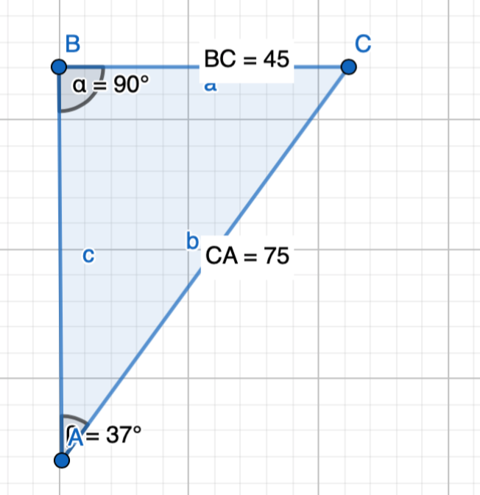
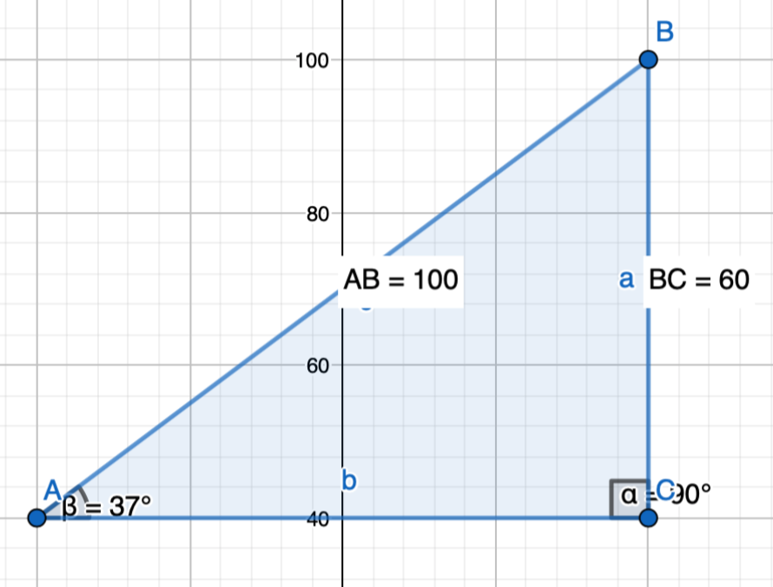
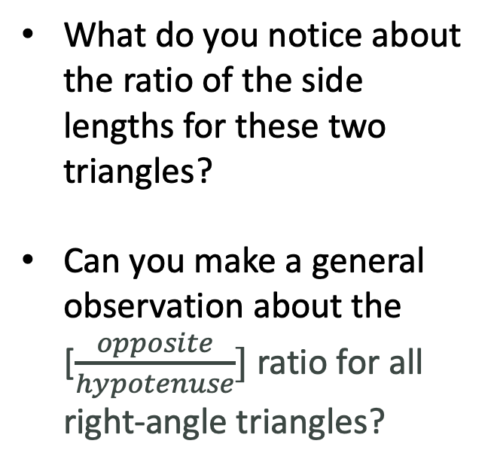
Topic: Trigonometry
EQ: What is the relationship between the hypotenuse and opposite sides in a right-angle triangle with a 30∘ angle?
Here are two right-angle triangles with an angle other than 30∘ and different side lengths.
What do you notice about the ratio of the side lengths for these two triangles?
Can you make a general observation about the [$\frac{opposite}{hypotenuse}]$ ratio for all right-angle triangles?

Slide 8
Topic: Trigonometry
EQ: What is the relationship between the hypotenuse and opposite sides in a right-angle triangle with a 30∘ angle?
https://www.geogebra.org/m/BSQb6R5w#material/Z3wcyhcB

Slide 9
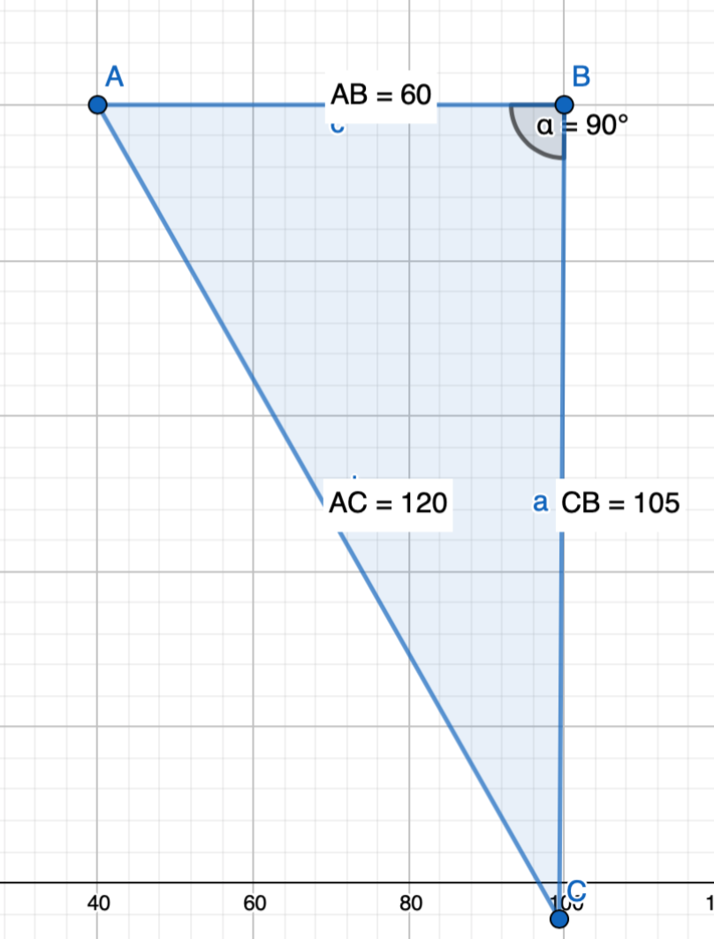
Exit Pass
1. How do you know this triangle has an angle of
30∘
2. Which two sides of a right-angle triangle does the
Sine law deal with?
3. Complete your summary by answering the EQ

